Slide 1
Wheeled Vehicle Dynamics
RBE500-F17-191
Lecture 07-04
Julian Center, Adj. Prof.

Slide 2
Differential Drive

Slide 3



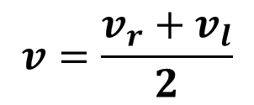
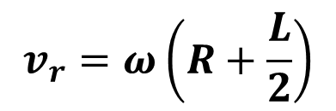

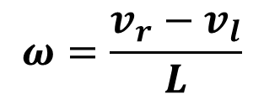
Differential Drive Model
ICC
y
ω
$$v=\frac{v_{r}+v_{l}}{2}$$
$$ω=\frac{v_{r}−v_{l}}{L}$$
v
l
$$if ω≠0$$
$$R=\frac{v}{ω}$$
R
θ
(x,y)
x
$$v_{r}=ω\left(R+\frac{L}{2}\right)$$
$$v_{l}=ω\left(R−\frac{L}{2}\right)$$
v
r
L/2
$$ICC=\left[x−Rsinθ, y+Rcosθ\right]$$

Slide 4
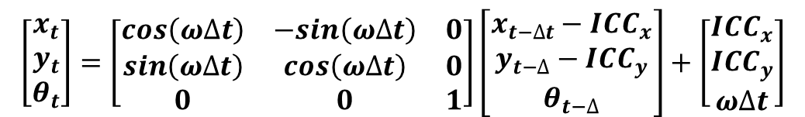





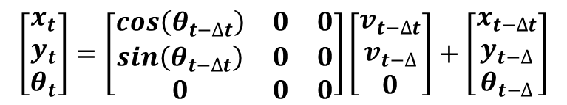
Differential Drive: Forward Kinematics
$$If ω≠0$$
ICC
$$\left[\begin{matrix}x_{t} \\ y_{t} \\ θ_{t}\end{matrix}\right]=\left[\begin{matrix}cos\left(ω∆t\right) & −sin\left(ω∆t\right) & 0 \\ sin\left(ω∆t\right) & cos\left(ω∆t\right) & 0 \\ 0 & 0 & 1\end{matrix}\right]\left[\begin{matrix}x_{t−∆t}−{ICC}_{x} \\ y_{t−∆}−{ICC}_{y} \\ θ_{t−∆}\end{matrix}\right]+\left[\begin{matrix}{ICC}_{x} \\ {ICC}_{y} \\ ω∆t\end{matrix}\right]$$
$$ω∆t$$
R
$$If ω=0$$
$$\left[\begin{matrix}x_{t} \\ y_{t} \\ θ_{t}\end{matrix}\right]=\left[\begin{matrix}cos\left(θ_{t−∆t}\right) & 0 & 0 \\ sin\left(θ_{t−∆t}\right) & 0 & 0 \\ 0 & 0 & 0\end{matrix}\right]\left[\begin{matrix}v_{t−∆t} \\ v_{t−∆} \\ 0\end{matrix}\right]+\left[\begin{matrix}x_{t−∆t} \\ y_{t−∆} \\ θ_{t−∆}\end{matrix}\right]$$
$$\left(x_{t},y_{t}\right)$$
$$\left(x_{t−∆t},y_{t−∆t}\right)$$

Slide 5
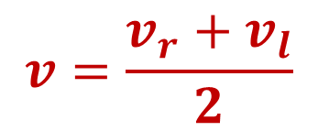

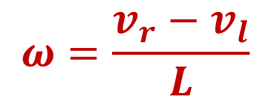


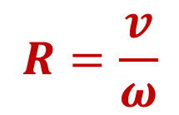
y
ω
$$ω=\frac{v_{r}−v_{l}}{L}$$
$$v=\frac{v_{r}+v_{l}}{2}$$
ICC
v
l
$$v$$
$$R=\frac{v}{ω}$$
R
θ
$$x,y$$
x
v
r
L/2
$$ICC=\left[\begin{matrix}x−Rsinθ \\ y+Rcosθ\end{matrix}\right]=\left[\begin{matrix}x_{c} \\ y_{c}\end{matrix}\right]$$

Slide 6
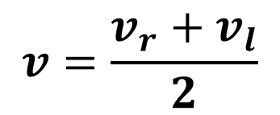
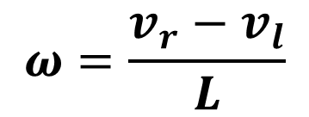
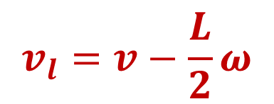
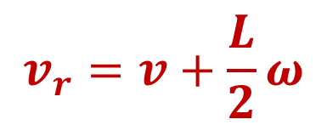
Differential Drive Motor Control Model
y
$$ω=\frac{v_{r}−v_{l}}{L}$$
$$v=\frac{v_{r}+v_{l}}{2}$$
ω
ICC
v
$$v_{r}=v+\frac{L}{2}ω$$
l
$$v$$
$$v_{l}=v−\frac{L}{2}ω$$
R
θ
$$x,y$$
x
v
r
L/2

Slide 7


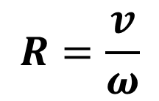
Unicycle Model of Differential Drive
y
$$ω=\frac{v_{r}−v_{l}}{L}$$
$$v=\frac{v_{r}+v_{l}}{2}$$
ω
ICC
$$R=\frac{v}{ω}$$
$$v$$
$$ICC=\left[\begin{matrix}x−Rsinθ \\ y+Rcosθ\end{matrix}\right]=\left[\begin{matrix}x_{c} \\ y_{c}\end{matrix}\right]$$
θ
R
$$x,y$$
x
L/2

Slide 8
Unicycle Model of Differential Drive
y
$$ω=\frac{v_{r}−v_{l}}{L}$$
$$v=\frac{v_{r}+v_{l}}{2}$$
ω
ICC
$$R=\frac{v}{ω}$$
$$v$$
$$ICC=\left[\begin{matrix}x−Rsinθ \\ y+Rcosθ\end{matrix}\right]=\left[\begin{matrix}x_{c} \\ y_{c}\end{matrix}\right]$$
θ
R
$$x,y$$
x

Slide 9
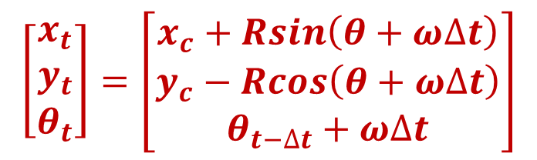

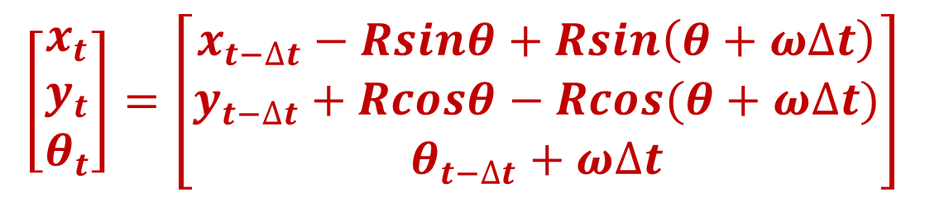
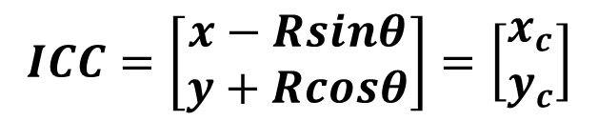
Unicycle Model of Differential Drive
$$ICC=\left[\begin{matrix}x−Rsinθ \\ y+Rcosθ\end{matrix}\right]=\left[\begin{matrix}x_{c} \\ y_{c}\end{matrix}\right]$$
y
ω
ICC
$$\left[\begin{matrix}x_{t} \\ y_{t} \\ θ_{t}\end{matrix}\right]=\left[\begin{matrix}x_{c}+Rsin\left(θ+ω∆t\right) \\ y_{c}−Rcos\left(θ+ω∆t\right) \\ θ_{t−∆t}+ω∆t\end{matrix}\right]$$
$$v$$
θ
R
$$x,y$$
x
$$ω∆t$$
$$\left[\begin{matrix}x_{t} \\ y_{t} \\ θ_{t}\end{matrix}\right]=\left[\begin{matrix}x_{t−∆t}−Rsinθ+Rsin\left(θ+ω∆t\right) \\ y_{t−∆t}+Rcosθ−Rcos(θ+ω∆t) \\ θ_{t−∆t}+ω∆t\end{matrix}\right]$$

Slide 10
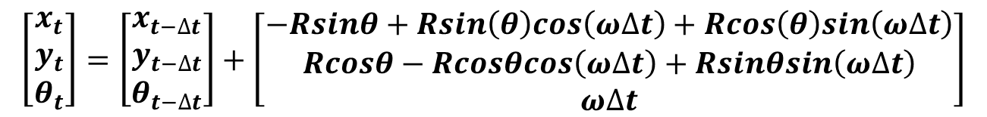
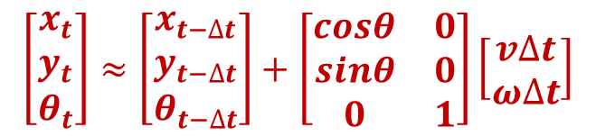
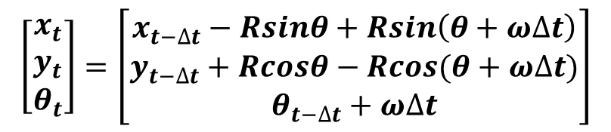
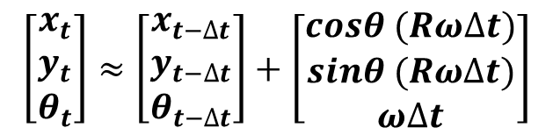

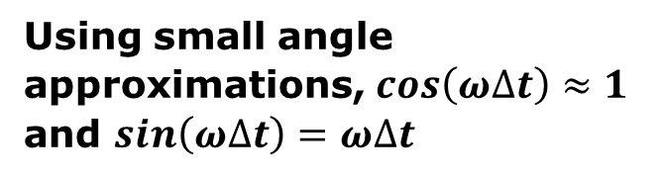
Perturbation Analysis
$$\left[\begin{matrix}x_{t} \\ y_{t} \\ θ_{t}\end{matrix}\right]=\left[\begin{matrix}x_{t−∆t}−Rsinθ+Rsin\left(θ+ω∆t\right) \\ y_{t−∆t}+Rcosθ−Rcos(θ+ω∆t) \\ θ_{t−∆t}+ω∆t\end{matrix}\right]$$
From the previous slide
Expanding the terms involving the sum of angles.
$$\left[\begin{matrix}x_{t} \\ y_{t} \\ θ_{t}\end{matrix}\right]=\left[\begin{matrix}x_{t−∆t} \\ y_{t−∆t} \\ θ_{t−∆t}\end{matrix}\right]+\left[\begin{matrix}−Rsinθ+Rsin\left(θ\right)cos\left(ω∆t\right)+Rcos\left(θ\right)sin\left(ω∆t\right) \\ Rcosθ−Rcosθcos\left(ω∆t\right)+Rsinθsin\left(ω∆t\right) \\ ω∆t\end{matrix}\right]$$
Using small angle approximations, $cos\left(ω∆t\right)≈1$ and $sin\left(ω∆t\right)=ω∆t$
$$\left[\begin{matrix}x_{t} \\ y_{t} \\ θ_{t}\end{matrix}\right]≈\left[\begin{matrix}x_{t−∆t} \\ y_{t−∆t} \\ θ_{t−∆t}\end{matrix}\right]+\left[\begin{matrix}cosθ (Rω∆t) \\ sinθ (Rω∆t) \\ ω∆t\end{matrix}\right]$$
$$\left[\begin{matrix}x_{t} \\ y_{t} \\ θ_{t}\end{matrix}\right]≈\left[\begin{matrix}x_{t−∆t} \\ y_{t−∆t} \\ θ_{t−∆t}\end{matrix}\right]+\left[\begin{matrix}cosθ & 0 \\ sinθ & 0 \\ 0 & 1\end{matrix}\right]\left[\begin{matrix}v∆t \\ ω∆t\end{matrix}\right]$$
And recalling that $Rω=v$

Slide 11


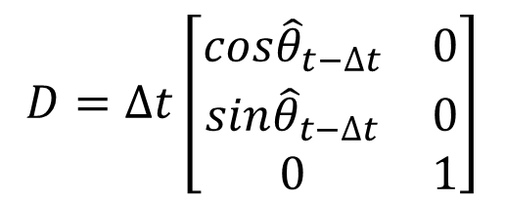

The Extended Kalman Filter
${\hat{x}}_{t}={\hat{x}}_{t−∆t}+cos{\hat{θ}}_{t−∆t} {\hat{v}}_{t−∆t} ∆t$
${\hat{y}}_{t}={\hat{y}}_{t−∆t}+sin{\hat{θ}}_{t−∆t} {\hat{v}}_{t−∆t} ∆t$
$${\hat{θ}}_{t}={\hat{θ}}_{t−∆t}+{\hat{ω}}_{t−∆t}∆t$$
$$D=∆t\left[\begin{matrix}cos{\hat{θ}}_{t−∆t} & 0 \\ sin{\hat{θ}}_{t−∆t} & 0 \\ 0 & 1\end{matrix}\right]$$

Slide 12

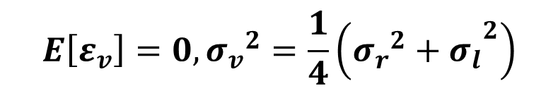
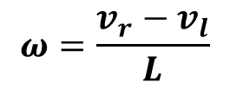



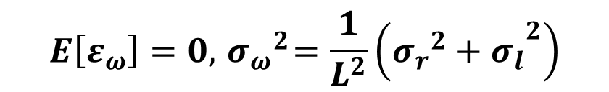


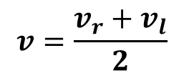

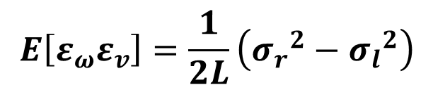
Covariance Calculations
Recall that
$$ω=\frac{v_{r}−v_{l}}{L}$$
$$v=\frac{v_{r}+v_{l}}{2}$$
Assuming zero mean, uncorrelated, additive noises on the wheel velocities.
$$v_{r}={\hat{v}}_{r}+ε_{r},$$
$$E\left[ε_{r}\right]=0, E\left[{ε_{r}}^{2}\right]={σ_{r}}^{2}$$
$$v_{l}={\hat{v}}_{l}+ε_{l},$$
$$E\left[ε_{l}\right]=0, E\left[{ε_{l}}^{2}\right]={σ_{l}}^{2}$$
$$E\left[ε_{r}ε_{l}\right]=0$$
Then
$$E\left[ε_{ω}\right]=0, { σ_{ω}}^{2}=\frac{1}{L^{2}}\left({{{σ_{r}}^{2}+σ}_{l}}^{2}\right)$$
$$ω=\hat{ω}+ε_{ω}$$
$$E\left[ε_{v}\right]=0,{σ_{v}}^{2}=\frac{1}{4}\left({{{σ_{r}}^{2}+σ}_{l}}^{2}\right)$$
$$v=\hat{v}+ε_{v}$$
These two may be correlated
$$E\left[ε_{ω}ε_{v}\right]=\frac{1}{2L}\left({σ_{r}}^{2}−{σ_{l}}^{2}\right)$$

Slide 13
Car Dynamics Model

Slide 14
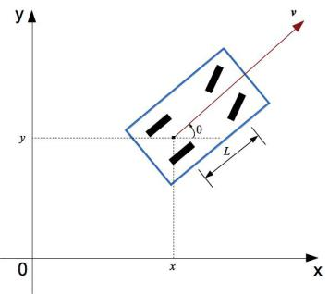
Car Dynamics Model

Slide 15


Car Dynamics Model
$$v_{fwd}$$
$$v_{rwd}$$

Slide 16
Bicycle Car Dynamics Model
$$v_{fwd}$$
$$v_{rwd}$$

Slide 17
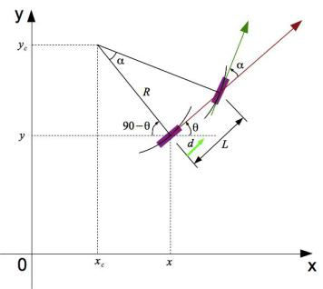




Simplified Bicycle Model
$$v_{f}$$
ICC
$$R_{f}$$
$$v_{r}$$
$$R_{r}$$

Slide 18
Car Dynamics
Rear Wheel Drive
https://nabinsharma.wordpress.com/2014/01/02/kinematics-of-a-robot-bicycle-model/
From Nabin Sharma

Slide 19
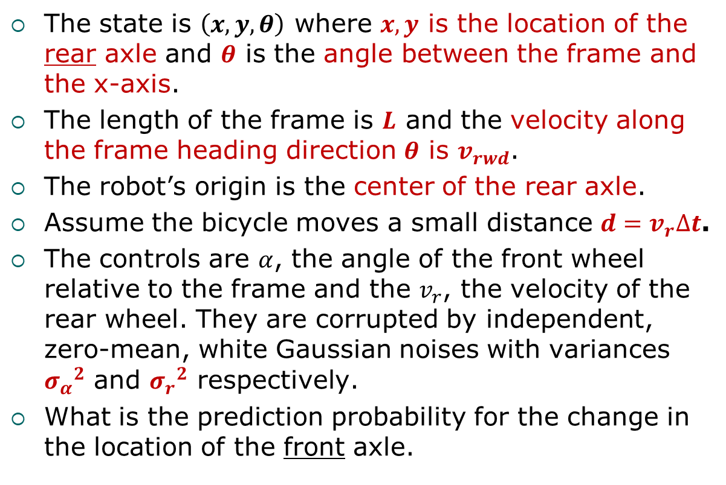
Rear Wheel Drive Model (1)
The state is $\left(x,y,θ\right)$ where $x,y$ is the location of the rear axle and $θ$ is the angle between the frame and the x-axis.
The length of the frame is $L$ and the velocity along the frame heading direction $θ$ is $v_{rwd}$.
The robot’s origin is the center of the rear axle.
Assume the bicycle moves a small distance $d=v_{r}∆t$.
The controls are $α$, the angle of the front wheel relative to the frame and the $v_{r}$, the velocity of the rear wheel. They are corrupted by independent, zero-mean, white Gaussian noises with variances ${σ_{α}}^{2}$ and ${σ_{r}}^{2}$ respectively.
What is the prediction probability for the change in the location of the front axle.

Slide 20

Simplified Bicycle Model
$$v_{f}$$
ICC
$$R_{f}$$
$$v_{r}$$
$$R_{r}$$
$$\tan{α}=\frac{L}{R_{rwd}}⇒R_{rw}=\frac{L}{\tan{α}}$$

Slide 21
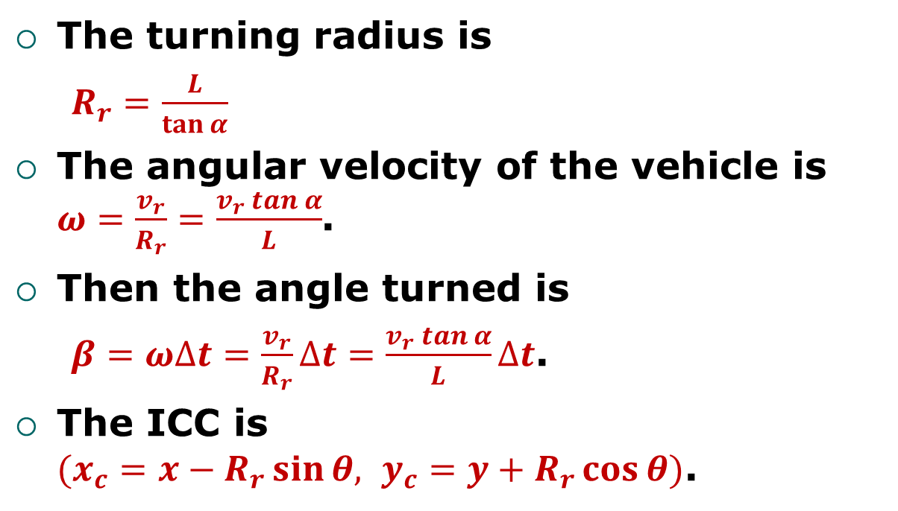
Rear Wheel Drive Model (2)
The turning radius is
$R_{r}=\frac{L}{\tan{α}}$
The angular velocity of the vehicle is $ω=\frac{v_{r}}{R_{r}}=\frac{v_{r} tan α}{L}$.
Then the angle turned is
$β{=ω∆t=\frac{v_{r}}{R_{r}}∆t}=\frac{v_{r} tan α}{L}∆t$.
The ICC is $(x_{c}=x−R_{r}\sin{θ, y_{c}=y+R_{r}\cos{θ)}}$.

Slide 22
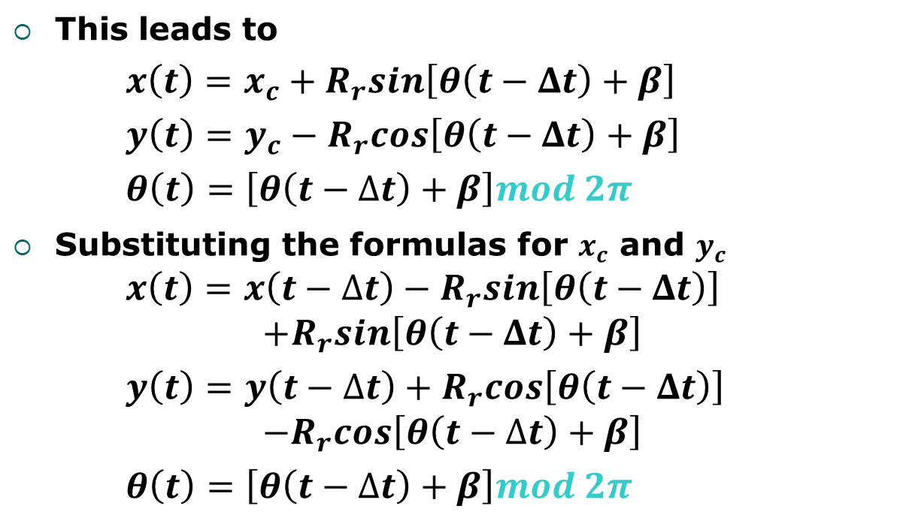
Rear Wheel Drive Model (3)
This leads to
$x\left(t\right)=x_{c}+R_{r}sin\left[θ\left(t−Δt\right)+β\right]$
$y\left(t\right)=y_{c}−R_{r}cos\left[θ\left(t−Δt\right)+β\right]$
$θ\left(t\right)=\left[θ\left(t−∆t\right)+β\right]mod 2π$
Substituting the formulas for $x_{c}$ and $y_{c}$ $x\left(t\right)=x\left(t−∆t\right)−R_{r}sin\left[θ\left(t−Δt\right)\right]$
$$+R_{r}sin\left[θ\left(t−Δt\right)+β\right]$$
$y\left(t\right)=y\left(t−∆t\right)+R_{r}cos\left[θ\left(t−Δt\right)\right]$
$$−R_{r}cos\left[θ\left(t−∆t\right)+β\right]$$
$θ\left(t\right)=\left[θ\left(t−∆t\right)+β\right]mod 2π$

Slide 23
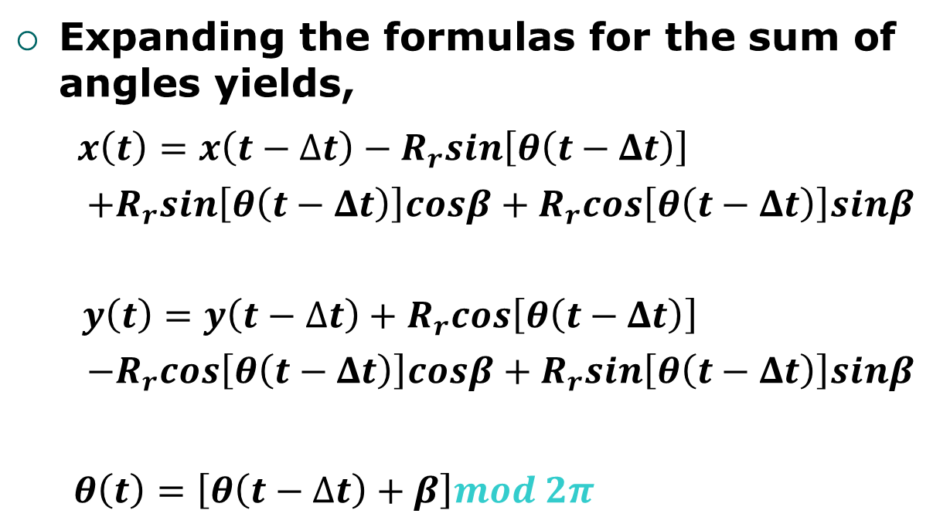
Rear Wheel Drive Model (4)
Expanding the formulas for the sum of angles yields,
$x\left(t\right)=x\left(t−∆t\right)−R_{r}sin\left[θ\left(t−Δt\right)\right]$
$+R_{r}sin\left[θ\left(t−Δt\right)\right]cosβ+R_{r}cos\left[θ\left(t−Δt\right)\right]sinβ$
$y\left(t\right)=y\left(t−∆t\right)+R_{r}cos\left[θ\left(t−Δt\right)\right]$
$−R_{r}cos\left[θ\left(t−Δt\right)\right]cosβ+R_{r}sin\left[θ\left(t−Δt\right)\right]sinβ$
$θ\left(t\right)=\left[θ\left(t−∆t\right)+β\right]mod 2π$

Slide 24
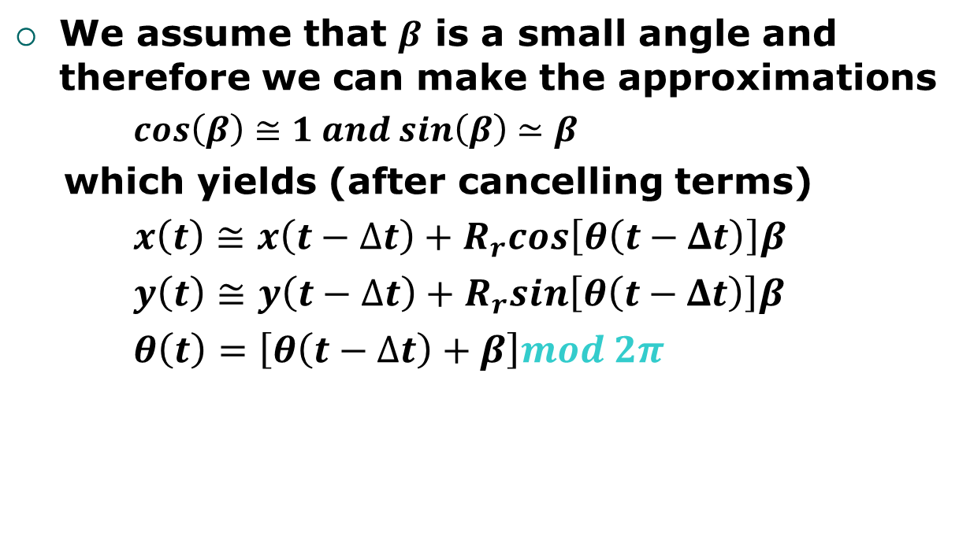
Rear Wheel Drive Model (5)
We assume that $β$ is a small angle and therefore we can make the approximations
$cos\left(β\right)≅1 and sin\left(β\right)≃β$
which yields (after cancelling terms)
$x\left(t\right)≅x\left(t−∆t\right)+R_{r}cos\left[θ\left(t−Δt\right)\right]β$
$y\left(t\right)≅y\left(t−∆t\right)+R_{r}sin\left[θ\left(t−Δt\right)\right]β$
$θ\left(t\right)=\left[θ\left(t−∆t\right)+β\right]mod 2π$

Slide 25
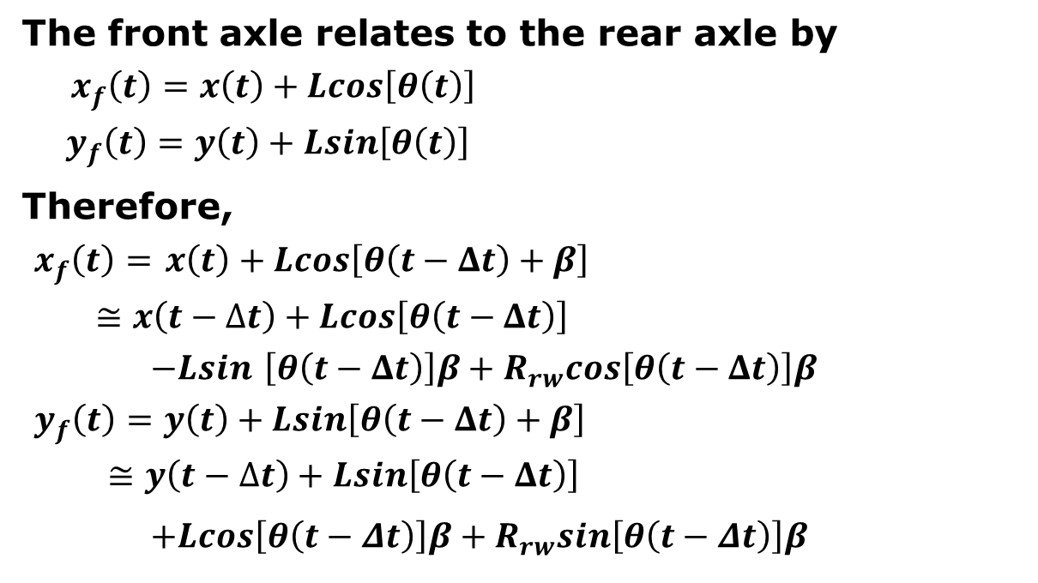
Rear Wheel Drive Model (6)
The front axle relates to the rear axle by
$x_{f}\left(t\right)=x\left(t\right)+Lcos\left[θ\left(t\right)\right]$
$y_{f}\left(t\right)=y\left(t\right)+Lsin\left[θ\left(t\right)\right]$
Therefore,
$x_{f}\left(t\right)=$ $x\left(t\right)+Lcos\left[θ\left(t−Δt\right)+β\right]$
$≅x\left(t−∆t\right)+Lcos\left[θ\left(t−Δt\right)\right]$
$−Lsin$ $\left[θ\left(t−Δt\right)\right]β+R_{rw}cos\left[θ\left(t−Δt\right)\right]β$
$y_{f}\left(t\right)=y\left(t\right)+Lsin\left[θ\left(t−Δt\right)+β\right]$
$≅y\left(t−∆t\right)+Lsin\left[θ\left(t−Δt\right)\right]$
$+Lcos\left[θ\left(t−Δt\right)\right]β+R_{rw}sin\left[θ\left(t−Δt\right)\right]β$

Slide 26
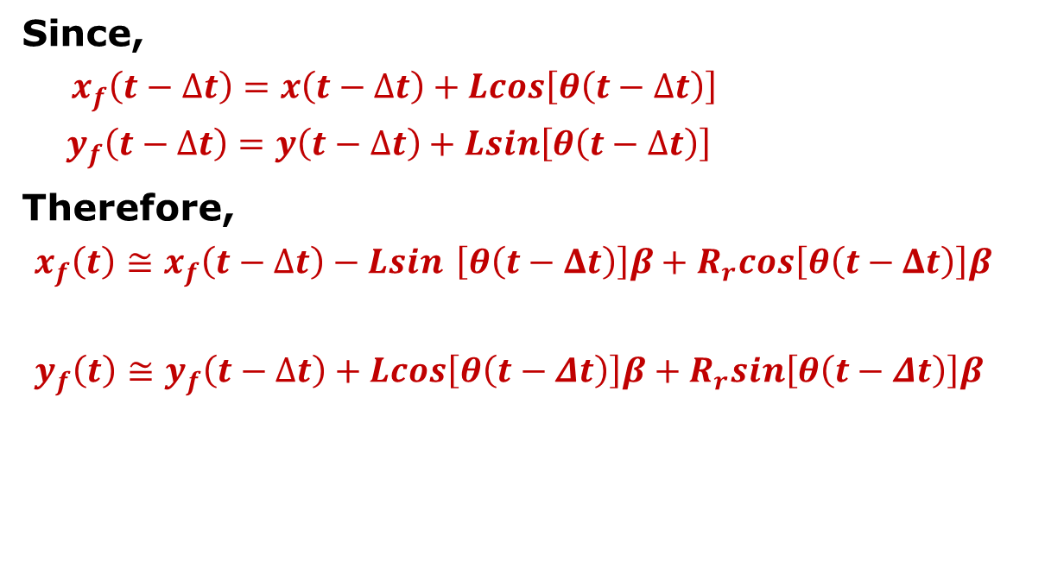
Rear Wheel Drive Model (7)
Since,
$x_{f}\left(t−∆t\right)=x\left(t−∆t\right)+Lcos\left[θ\left(t−∆t\right)\right]$
$y_{f}\left(t−∆t\right)=y\left(t−∆t\right)+Lsin\left[θ\left(t−∆t\right)\right]$
Therefore,
$x_{f}\left(t\right)≅x_{f}\left(t−∆t\right)−Lsin$ $\left[θ\left(t−Δt\right)\right]β+R_{r}cos\left[θ\left(t−Δt\right)\right]β$
$y_{f}\left(t\right)≅y_{f}\left(t−∆t\right)+Lcos\left[θ\left(t−Δt\right)\right]β+R_{r}sin\left[θ\left(t−Δt\right)\right]β$

Slide 27
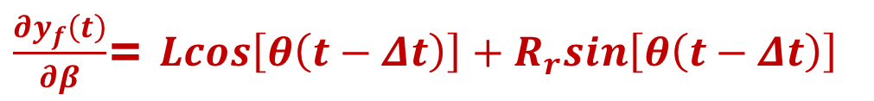
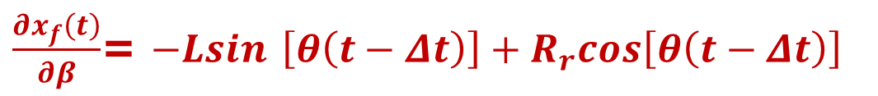

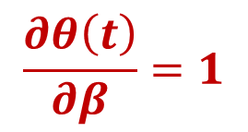
Computing the Control Noise Matrix(1)
We can get the relationship of the state to control noises by first taking the derivatives of the state with respect to $β$
$\frac{∂x_{f}\left(t\right)}{∂β}$= $−Lsin$ $\left[θ\left(t−Δt\right)\right]+R_{r}cos\left[θ\left(t−Δt\right)\right]$
$\frac{∂y_{f}\left(t\right)}{∂β}$= $Lcos\left[θ\left(t−Δt\right)\right]+R_{r}sin\left[θ\left(t−Δt\right)\right]$
$$\frac{∂θ\left(t\right)}{∂β}=1$$

Slide 28
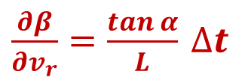
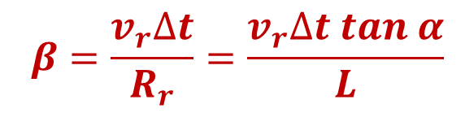
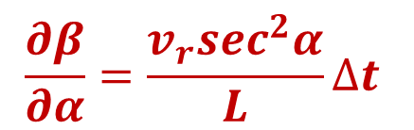
Computing the Control Noise Matrix(2)
Then we recall that
$$β{=\frac{v_{r}∆t}{R_{r}}}=\frac{v_{r}∆t tan α}{L}$$
Therefore,
$\frac{∂β}{∂v_{r}}=\frac{tan α}{L}$ $∆t$
$$\frac{∂β}{∂α}=\frac{v_{r}\sec^{2}α}{L}∆t$$

Slide 29
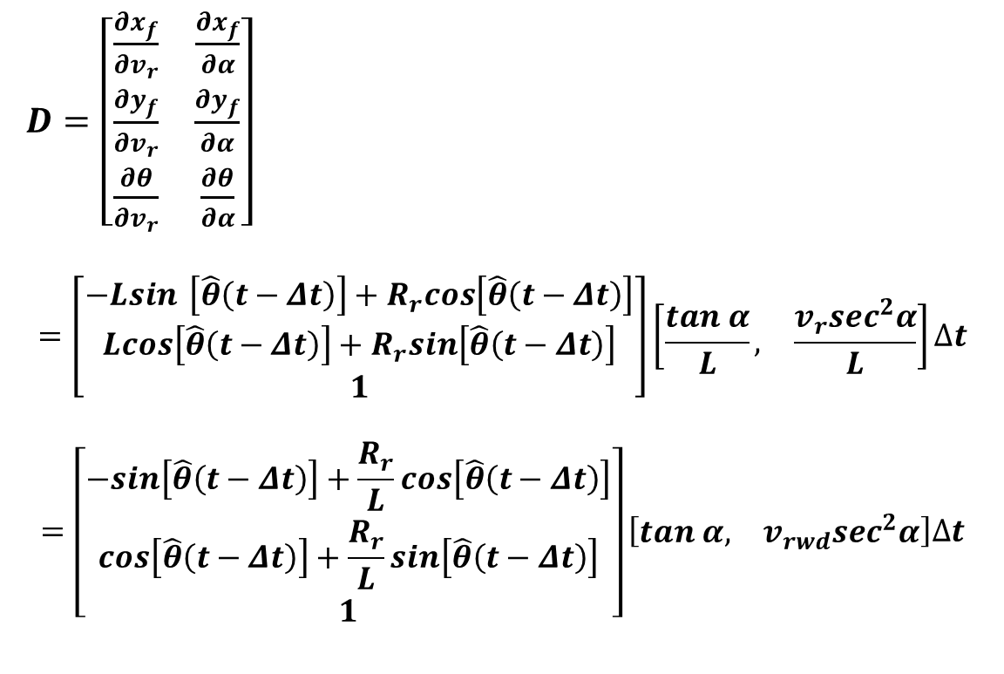
Computing the Control Noise Matrix(2)
Using the chain rule to put these results together yields
$D=\left[\begin{matrix}\frac{∂x_{f}}{∂v_{r}} & \frac{∂x_{f}}{∂α} \\ \frac{∂y_{f}}{∂v_{r}} & \frac{∂y_{f}}{∂α} \\ \frac{∂θ}{∂v_{r}} & \frac{∂θ}{∂α}\end{matrix}\right]$
$$=\left[\begin{matrix}−Lsin \left[\hat{θ}\left(t−Δt\right)\right]+R_{r}cos\left[\hat{θ}\left(t−Δt\right)\right] \\ Lcos\left[\hat{θ}\left(t−Δt\right)\right]+R_{r}sin\left[\hat{θ}\left(t−Δt\right)\right] \\ 1\end{matrix}\right]\left[\begin{matrix}\frac{tan α}{L}, & \frac{v_{r}\sec^{2}α}{L}\end{matrix}\right]∆t$$
$$=\left[\begin{matrix}−sin\left[\hat{θ}\left(t−Δt\right)\right]+\frac{R_{r}}{L}cos\left[\hat{θ}\left(t−Δt\right)\right] \\ cos\left[\hat{θ}\left(t−Δt\right)\right]+\frac{R_{r}}{L}sin\left[\hat{θ}\left(t−Δt\right)\right] \\ 1\end{matrix}\right]\left[\begin{matrix}tan α, & v_{rwd}\sec^{2}α\end{matrix}\right]∆t$$

Slide 30
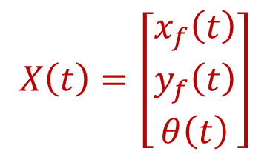
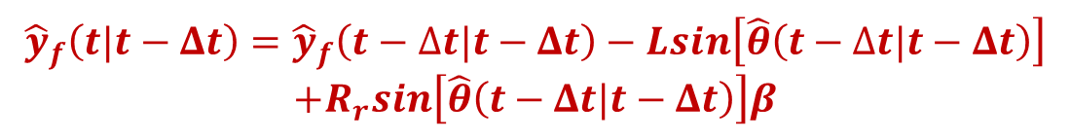
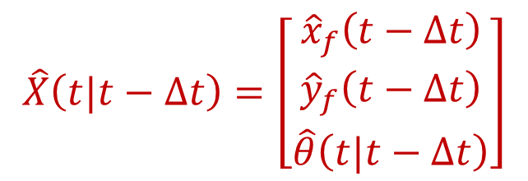
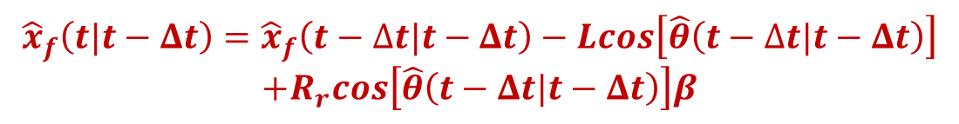
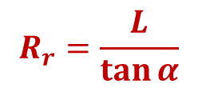

Extended Kalman Filter Prediction State Equations
$$β{=}\frac{v_{r} tan α}{L}∆t$$
$$R_{r}=\frac{L}{\tan{α}}$$
$${\hat{x}}_{f}\left(t|t−Δt\right)={\hat{x}}_{f}\left(t−∆t|t−Δt\right)−Lcos\left[\hat{θ}\left(t−∆t|t−Δt\right)\right]$$
$$+R_{r}cos\left[\hat{θ}\left(t−Δt|t−Δt\right)\right]β$$
$${\hat{y}}_{f}\left(t|t−Δt\right)={\hat{y}}_{f}\left(t−∆t|t−Δt\right)−Lsin\left[\hat{θ}\left(t−∆t|t−Δt\right)\right]$$
$$+R_{r}sin\left[\hat{θ}\left(t−Δt|t−Δt\right)\right]β$$
$$\hat{θ}\left(t|t−Δt\right)=\left[\hat{θ}\left(t−∆t|t−Δt\right)+β\right]mod 2π$$
For notational convenience, let
$$X\left(t\right)=\left[\begin{matrix}x_{f}\left(t\right) \\ y_{f}\left(t\right) \\ θ\left(t\right)\end{matrix}\right]$$
$$\hat{X}\left(t|t−Δt\right)=\left[\begin{matrix}{\hat{x}}_{f}\left(t−Δt\right) \\ {\hat{y}}_{f}\left(t−Δt\right) \\ \hat{θ}\left(t|t−Δt\right)\end{matrix}\right]$$
and

Slide 31

Extended Kalman Filter Covarince Prediction Equations
The covariance matrix of the prediction is
$$P\left(t|t−Δt\right)=P\left(t−∆t|t−∆t\right)+DUD^{T}+R$$
where
$$U=\left[\begin{matrix}{σ_{r}}^{2} & 0 \\ 0 & {σ_{α}}^{2}\end{matrix}\right]$$
and R is selected to keep the filter from diverging
Therefore, the prediction probability is
$$p\left[X\left(t|t−∆t\right)\right]=𝓝\left[X\left(t|t−∆t\right);\hat{X}\left(t|t−∆t\right);P\left(t−∆t|t−∆t\right)\right]$$

Slide 32
Car Dynamics Model
Front Wheel Drive

Slide 33
Front Wheel Drive Bicycle Model
May be on your midterm.
Much simpler solution.

